Slide 1
Project Presentation on
Predictive Maintenance for Automobiles Using IoT & Machine Learning
Presented by
Group No | Name | USN
13 | ANAND S.S | 1AY21EC012
 | LAXMAN M N | 1AY21EC060
 | KEERTHAN C.K | 1AY22EC402
 | TARUN K.H | 1AY22EC410
Guide Name: Mr. Jagadish M Designation: Assistant Professor

Slide 2

Table of Contents
Introduction
Proposed Solution
Objectives
System Architecture
Challenges and Limitations
Project Outcome
Conclusion
References

Slide 3

INTRODUCTION
What is Predictive Maintenance?
A proactive maintenance strategy that predicts when vehicle components are likely to fail using IoT sensors, real-time data, and machine learning.
Why This Approach?
Traditional maintenance methods lead to unnecessary part replacements & unexpected breakdowns. Our goal is to improve vehicle reliability, reduce costs, and minimize downtime.
Our project focuses on implementing predictive maintenance for automotive systems using IoT, With the sensor data and real-time monitoring, the system predicts potential failures, reducing downtime and maintenance costs, while improving vehicle performance and safety.

Slide 4
Problem Overview
Unplanned vehicle breakdowns lead to :
costly repairs
unexpected downtime
safety risks.
Present maintenance methods are ineffective because they rely totally on servicing that is scheduled or based on break-down/reactive events.
There is a growing need for an intelligent, real-time solution that predicts failures before they occur, ensuring :
Consistent performance
Safety
Cost-efficiency in automotive systems.

Slide 5

Proposed Solution
We developed a cost-effective predictive maintenance (Pd.M.) system that continuously monitors the health of critical vehicle components using IoT-enabled sensors and machine learning models, featuring :
Reduced Downtime
Cost Savings
Improved Safety
Optimized Maintenance
Real-Time Insights
Environmental Impact

Slide 6
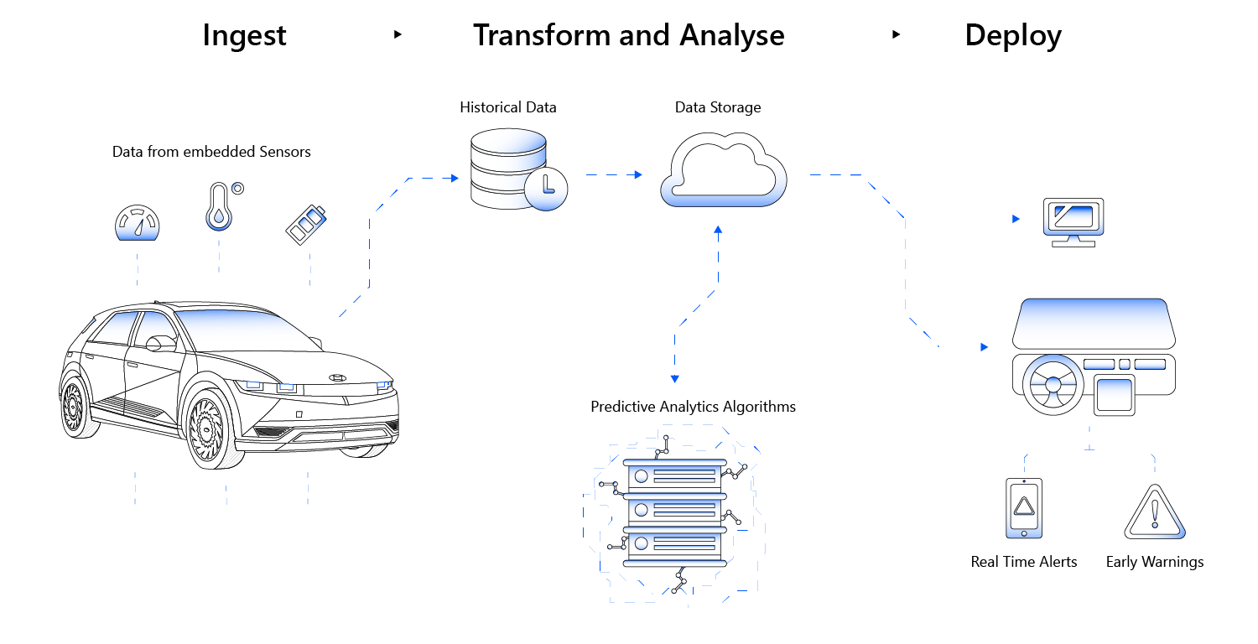
OBJECTIVES
Integrate Critical Sensors for monitoring key vehicle components.
Develop a ML Model to predict remaining useful life (RUL) of components & provide Analytics.
Alert Mechanism to analyze sensor data and trigger alerts when parts are predicted to fail soon.

Slide 7
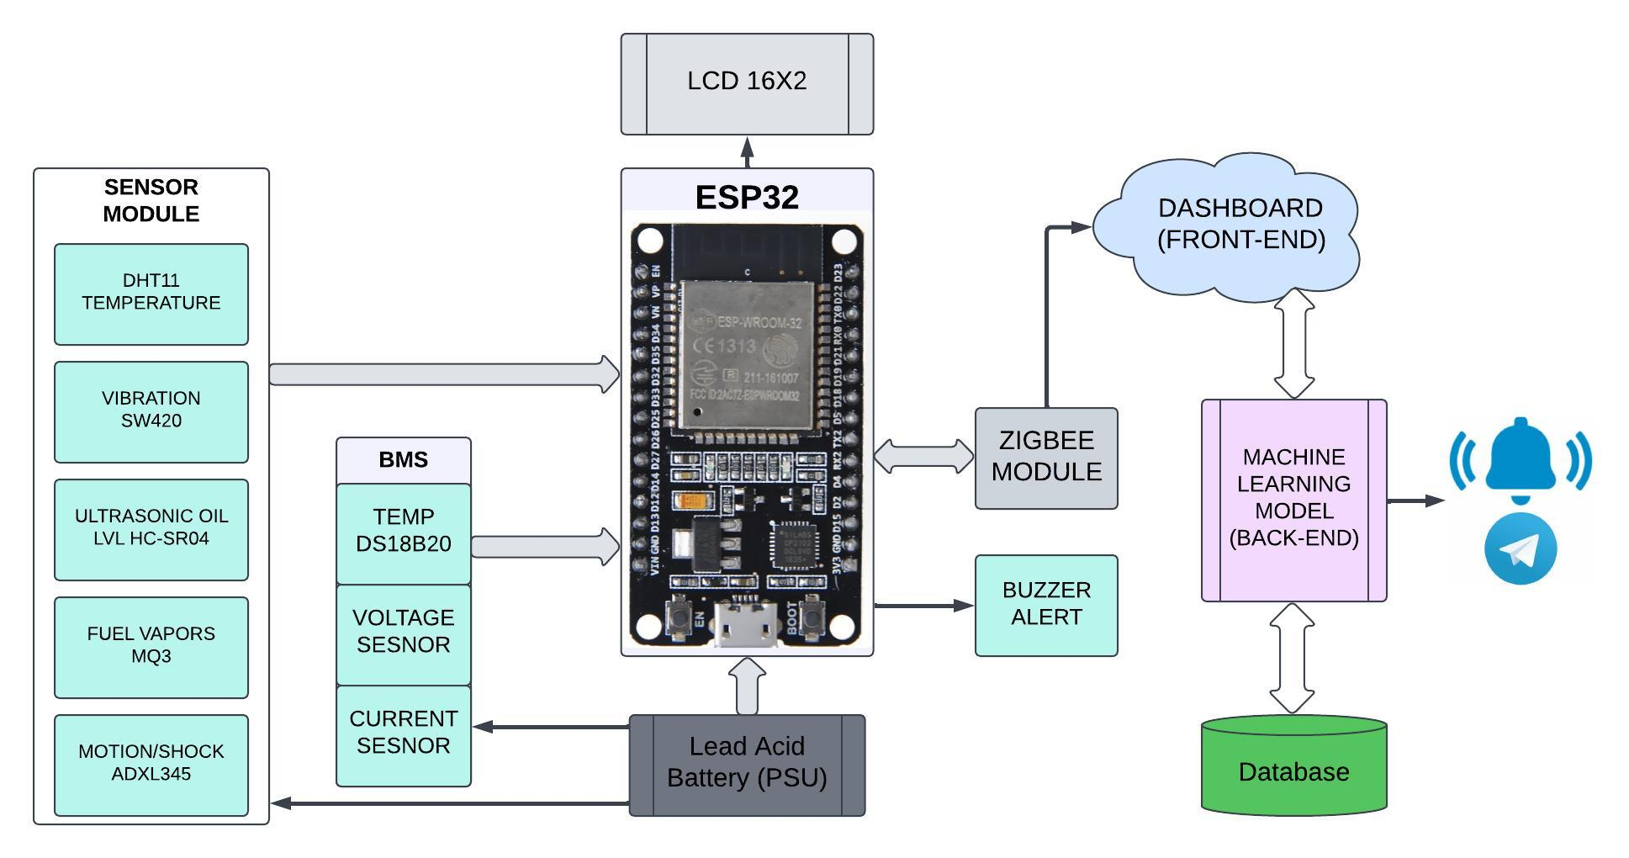
System Architecture
Fig: Block Diagram of Predictive maintenance of automobiles using IoT & ML

Slide 8


Software
Back-End Tech
.
Python-based micro web framework, a lightweight server with web interface
Built on WERKZEUG WSGI Toolkit and Jinja2 Template Engine.
Features:
Simple, lightweight, and extendable.
Enables fast web development without complex configurations.
.
Self-contained, serverless SQL database.
To store and manage sensor data efficiently

Slide 9
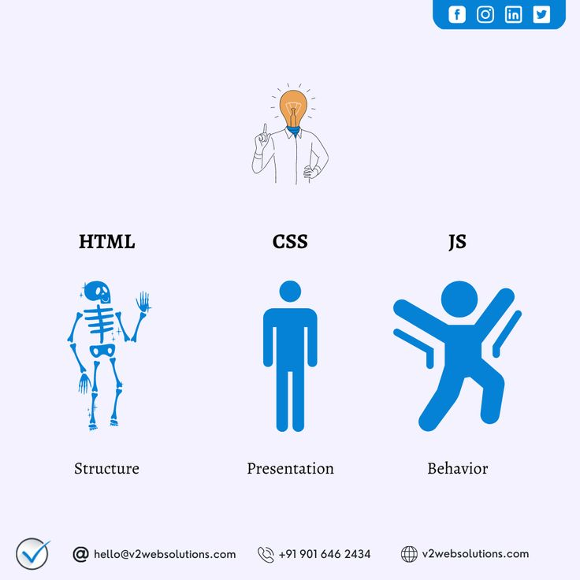
Software
Front-End Tech
HTML (Hypertext Markup Language)
Defines structure & layout for web.
Creation of static & dynamic web.
CSS (Cascading Style Sheets)
Adds styling to HTML elements.
Saves time with reusable styles.
Allows responsive designs for multiple devices.
JavaScript
A lightweight, dynamic programming language for client-side interaction.
Enables dynamic and interactive web content.
Integrated seamlessly with HTML and CSS.

Slide 10

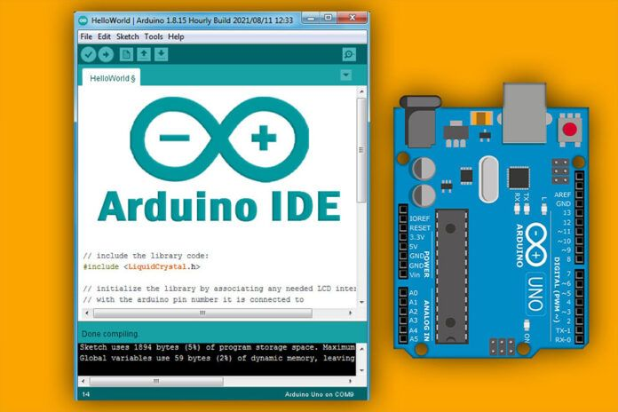
Editing Tools
.
Multi-purpose Development Tool – Used for writing, debugging, and managing code for web front-end, back-end, database, and machine learning models
Features:
Simple & handy with user-friendly GUI.
.
Embedded Systems Programming – Used for writing, compiling, and uploading code to the ESP32 microcontroller.
Built-in Libraries, Serial Monitor & Plotter, Supports Multiple Boards, Lightweight & Fast Compilation.

Slide 11
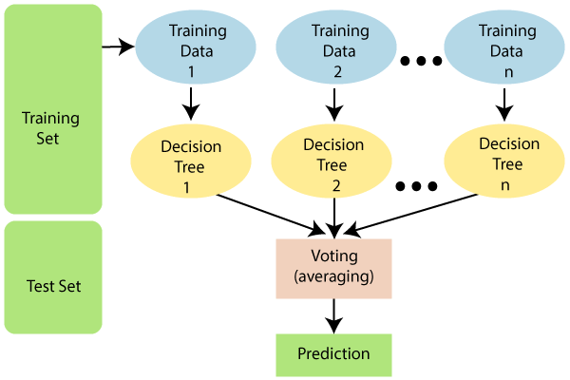
ML Model: Random Forest Algorithm
• A random forest is just a group of many decision trees working together.
• Each tree gives its answer, and the forest takes a vote to decide the final answer.
If most trees say the car is fine, the forest says, "The car is fine."
If most trees say there’s a problem, the forest says, "Fix it now!"

Slide 12
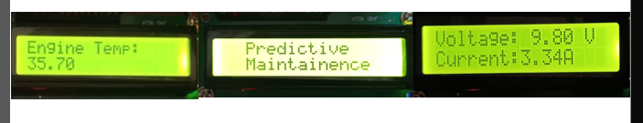
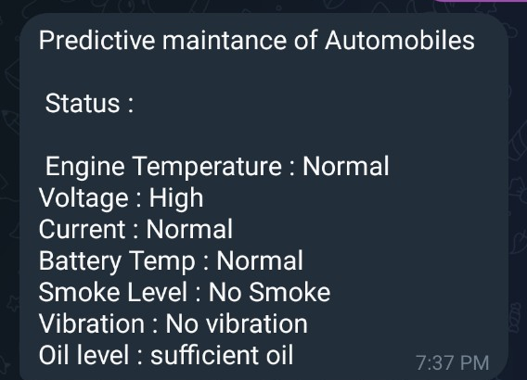
Alert Mechanism in PDM System
LCD Panel (On-Vehicle Alert System)
✅ Real-Time Notifications : Displays critical alerts directly on the vehicle.
✅ Immediate Attention : Ensures the driver or maintenance personnel are aware of issues like overheating or excessive vibration.
✅ Simple & Reliable : No internet dependency, making it an ideal local alert system.
2. Telegram Bot (Remote Notification System)
✅Instant Mobile Alerts : Sends real-time notifications to users via Telegram.
✅Remote Monitoring : Allows users to check vehicle status from anywhere.
✅Interactive System : Users can query the system for live sensor data and
fault history.

Slide 13
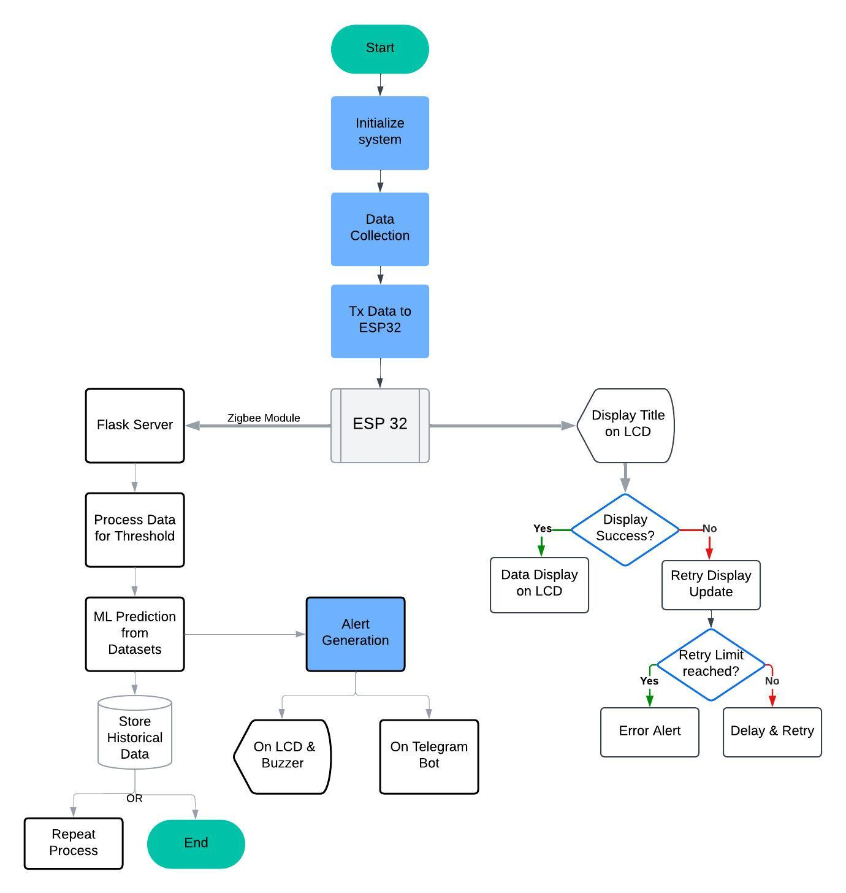
Flowchart

Slide 14
Challenges and Limitations
Data Collection & Sensor calibration:
Difficulty in obtaining real-world sensor data for training the machine learning model.
Database Integration:
Challenges in integrating SQLite with real-time data from sensors.
Ensuring efficient storage and retrieval of large datasets.
Model Deployment:
Integrating the RFT model into the Flask back-end for real-time predictions were a demanding task.
Connectivity Issues:
Wi-Fi dependency cause delays in transmitting data to the database and web interface.
Scalability:
The prototype is limited to small-scale testing and may require upgrades to handle larger, real-world systems.

Slide 15

Project Outcome
Implemented a system for the continuous monitoring of critical parameters in vehicles: Temperature, vibration, oil level, battery status, etc.
Anomaly Detection for conditions such as: Overheating, low oil levels, vibration irregularities, and gas leaks.
Utilized a Random Forest ML model to predict: RUL of components, Early warning of potential failures.
Generated real-time alerts via: LCD display & telegram bot .
Developed a user-friendly dashboard using Python Flask & Stored historical data in SQLite for trend analysis.
Developed a modular system using affordable technology.

Slide 16

Conclusion
By integrating IoT and ML, our system enhances vehicle safety, optimizes maintenance, and reduces unexpected failures, making automotive systems smarter and more reliable. With continuous monitoring and notification for anomalies to eliminate probable downtime and costs on repair of machines. In return, the system provides this facility by improving the chances for better reliability in order to have smart, and safe automotive systems. Predictive maintenance has become a viable solution for keeping machines running smooth and efficiently.

Slide 17
References
Zhang, Y., Li, H., & Tang, X. (2020). Machine learning in autonomous vehicles: A survey. *IEEE Transactions on Intelligent Transportation Systems*, 1-18. doi: [10.1109/TITS.2020.2974558](https://doi.or g/10.1109/TITS.2020.2974558)
Kim, K., et al. (2019). A survey on predictive maintenance in autonomous vehicle systems. *Sensors*, 19(16), 3543. DOI: [10.3390/s19163543](https://doi.org/10.339 0/s19163543)
Surabhi, S. N. D., Shah, C., Mandala, V., & Shah, P. (2024). Range Prediction based on Battery Degradation and Vehicle Mileage for Battery Electric Vehicles. International Journal of Science and Research, 13, 952- 958.
Jiang, R., et al. (2021). Predictive maintenance of autonomous vehicles using machine learning and internet of things. *Sustainable Computing: Informatics and Systems*, 31, 100506. doi: [10.1016/j.suscom.2021.100506](https://doi. org/10.1016/j.suscom.2021.100506)
Wang, Z., et al. (2018). Machine learningbased predictive maintenance for autonomous vehicle systems. In *2018 IEEE Intelligent Vehicles Symposium (IV)* (pp. 1613-1618). doi: [10.1109/IVS.2018.8500624](https://doi.org /10.1109/IVS.2018.8500624)

